Slide 1
Angular
Anil K

Slide 2
Built-in Directives
Style
It is used to set the CSS property value dynamically at run time.
When the value of component property is changed, the value of css property will be automatically gets changed.
Syntax: <tag [style.cssproperty]=”component property”> </tag>
Style - Example
c:\angular\app1\src\app\app.component.html
<div>
<h4>Style</h4>
<div [style.color]="mycolor">{{marks}}</div>
</div>
c:\angular\app1\src\app\app.component.css
.class1 { color: green; font-size: 30px; }
.class2 { color: red; font-size: 26px; }

Slide 3
c:\angular\app1\src\app\app.module.ts
import { BrowserModule } from '@angular/platform-browser’;
import { NgModule } from '@angular/core’;
import { AppComponent } from './app.component’;
import { FormsModule } from "@angular/forms";
@NgModule({
declarations: [ AppComponent ],
imports: [ BrowserModule, FormsModule ],
providers: [],
bootstrap: [AppComponent]
})
export class AppModule { }

Slide 4
c:\angular\app1\src\app\app.component.ts
import { Component } from "@angular/core";
@Component({
selector: 'app-root',
templateUrl: './app.component.html',
styleUrls: ['./app.component.css']
}) export class AppComponent {
marks: number = 70;
myclass: string = "";
constructor() {
if (this.marks >= 35) {
this.myclass = "class1";
} else {
this.myclass = "class2";
}
}
}

Slide 5
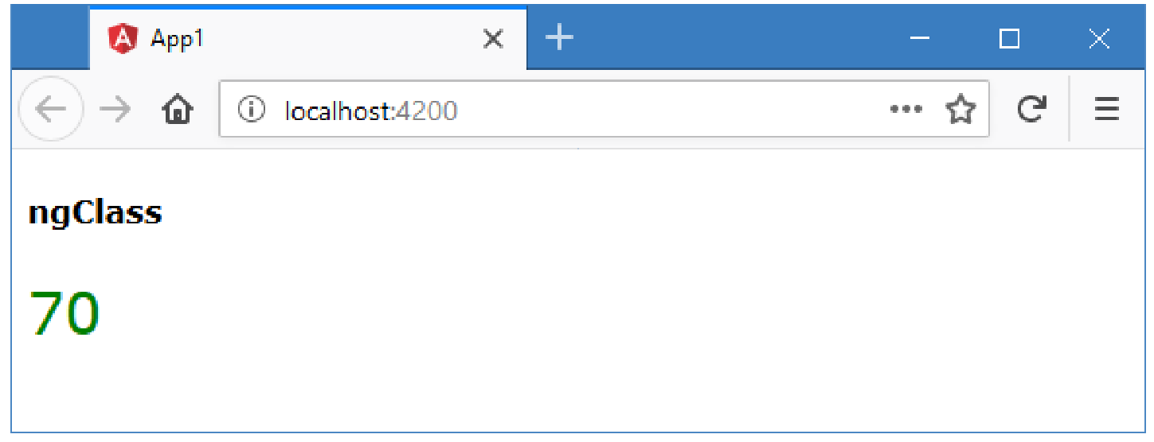

Slide 6
ngIf
The “ngIf” displays the element if the condition is “true”; otherwise the element will be deleted from DOM.
Syntax: <tag *ngIf=”condition”> </tag>
The “ngIf” must be prefixed with “*”, to mark that it accepts “micro syntax”, which is not just an “expression”, it accepts its own syntax.
Use “ngIf” if you want to display some content based on the condition. The content appers when the condition is true, it disappears when the condition is false.
ngIf – Example
c:\angular\app1\src\app\app.component.html
<div>
<h4>ngIf</h4>
<div *ngIf="b" style="background-color:#33ff66"> Congratulations! </div>
<div *ngIf="!b" style="background-color:#00ccff"> Better luck next time!! </div>
</div>

Slide 7
c: \angular\ app1\ src\ app\ app.module.ts
import {BrowserModule} from '@angular/platform-browser';
import {NgModule} from '@angular/core';
import {AppComponent} from './app.component';
import {FormsModule} from "@angular/forms";
@NgModule({
declarations: [AppComponent],
imports: [BrowserModule, FormsModule],
providers: [],
bootstrap: [AppComponent]
}) export class AppModule {}

Slide 8
c:\angular\app1\src\app\app.component.ts
import { Component } from "@angular/core";
@Component({
selector: 'app-root',
templateUrl: './app.component.html',
styleUrls: ['./app.component.css']
}) export class AppComponent {
marks: number = 70;
b: boolean;
constructor() {
if (this.marks >= 35) {
this.b = true;
} else {
this.b = false;
}
}
}

Slide 9
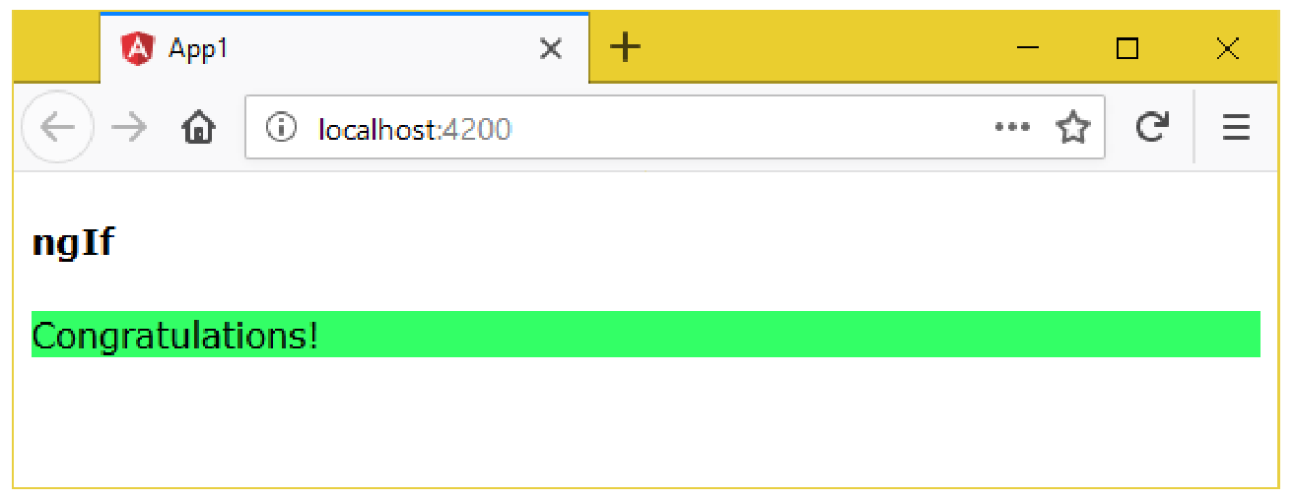

Slide 10
ngIf and else
The “ngIf and else” displays one element if it is “true”; otherwise it displays another element.
Syntax:
<tag *ngIf=”condition; then template1; else template2”> </tag>
<ng-template #template1>
…
</ng-template>
<ng-template #template2>
…
</ng-template>
The “ng-template” is a container, inside which you can place any no. of tags.
Use “ngIf and else”, if you want to display one content for the “true” case, another content for the “false” case.

Slide 11
ngIf and else - Example
c:\angular\app1\src\app\app.component.html
<div>
<h4>ngIf and else</h4>
<div *ngIf="b; then template1; else template2"> </div>
<ng-template #template1>
<div style="background-color:#33ff66"> Congratulations! </div>
</ng-template>
<ng-template #template2>
<div style="background-color:#00ccff"> Better luck next time!! </div>
</ng-template>
</div>

Slide 12
c: \angular\ app1\ src\ app\ app.module.ts
import {BrowserModule} from '@angular/platform-browser';
import {NgModule} from '@angular/core';
import {AppComponent} from './app.component';
import {FormsModule} from "@angular/forms";
@NgModule({
declarations: [AppComponent],
imports: [BrowserModule, FormsModule],
providers: [],
bootstrap: [AppComponent]
})
export class AppModule {}

Slide 13
c: \angular\ app1\ src\ app\ app.component.ts
import {Component} from "@angular/core";
@Component({
selector: 'app-root',
templateUrl: './app.component.html',
styleUrls: ['./app.component.css']
}) export class AppComponent {
marks: number = 70;
b: boolean;
constructor() {
if (this.marks >= 35) {
this.b = true;
} else {
this.b = false;
}
}
}

Slide 14
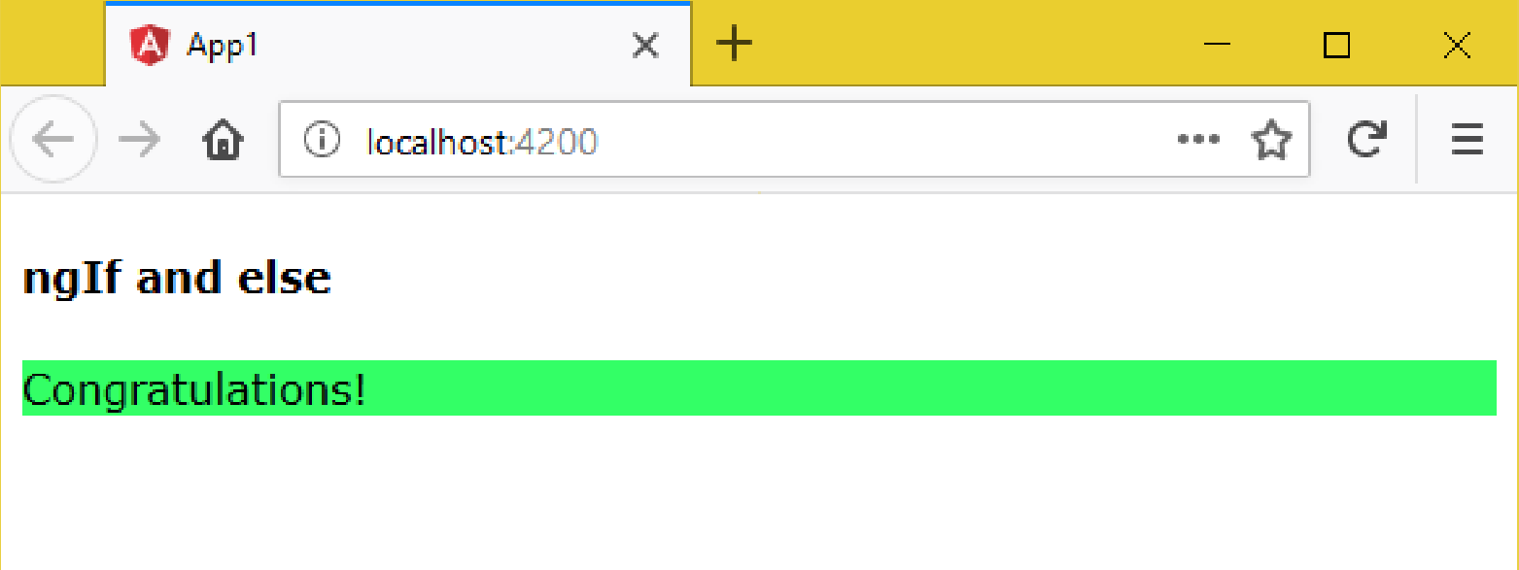

Slide 15
ngSwitch
The “ngSwitch” checks the value of a variable, whether it matches with any one of the “cases” and displays the element when it matches with anyone.
Use “ngSwitch” if you want to display some content for every possible value in a variable.
Syntax:
<tag [ngSwitch] =”property”>
<tag *ngSwitchCase=” ‘value‘ ”></tag>
<tag *ngSwitchCase=” ‘value‘ ”></tag>
<tag *ngSwitchCase=” ‘value‘ ”></tag>
…
<tag *ngSwitchDefault></tag>
</tag>

Slide 16
ngSwitch - Example
c: \angular\ app1\ src\ app\ app.module.ts
import {BrowserModule} from '@angular/platform-browser';
import {NgModule} from '@angular/core';
import { AppComponent} from './app.component';
import {FormsModule} from "@angular/forms";
@NgModule({
declarations: [AppComponent],
imports: [BrowserModule, FormsModule],
providers: [],
bootstrap: [AppComponent]
}) export class AppModule {}

Slide 17
c: \angular\ app1\ src\ app\ app.component.ts
import {Component} from "@angular/core";
@Component({
selector: 'app-root',
templateUrl: './app.component.html',
styleUrls: ['./app.component.css']
})
export class AppComponent {
country: string = null;
}

Slide 18
c:\angular\app1\src\app\app.component.html
<div>
<h4>ngSwitch</h4> <select [(ngModel)]="country">
<option></option>
<option>India</option>
<option>UK</option>
<option>US</option>
</select>
<div [ngSwitch]="country">
<p *ngSwitchCase="'India'"> India details here </p>
<p *ngSwitchCase="'UK'"> UK details here </p>
<p *ngSwitchCase="'US'"> US details here </p>
<p *ngSwitchDefault> Please select any country </p>
</div>
</div>

Slide 19
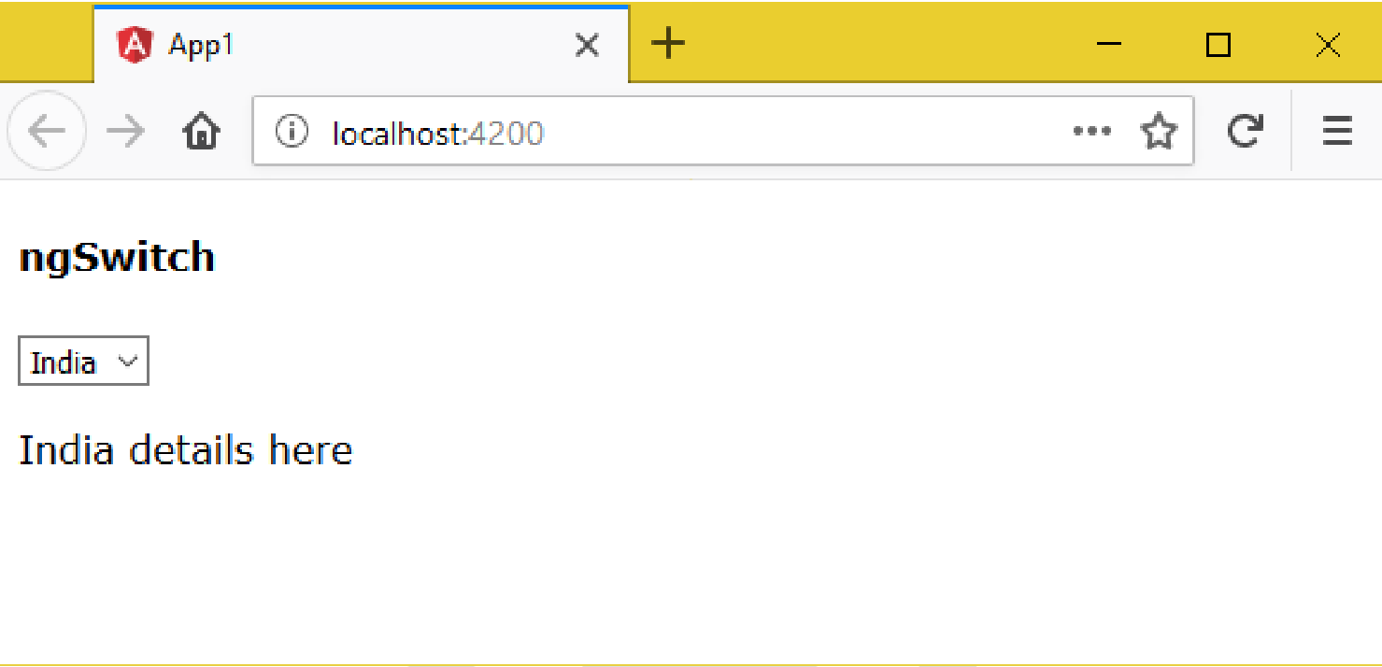

Slide 20
ngFor
It is used to repeat the tag once for each element in the array. It generates (repeats) the give content once for one element of the array. For example, you are reading friends names from an array and displaying the same as a bulleted list.
We have to prefix “*” before ”ngFor”, as it is the micro syntax. The “micro syntax” means, it’s not just a value;
we can write some complex code in it. arrayname = [ value1, value2, … ];
Ex: Displaying proucts list in the online shopping website.
Use “ngFor” to display list of records. Ex: List of banks, list of salesman and their sales etc.
Syntax:
<tag *ngFor=”let variable of arrayname”> </tag>

Slide 21
ngFor - Example
c: \angular\ app1\ src\ app\ app.component.ts
import {
Component
} from "@angular/core";
@Component({
selector: 'app-root',
templateUrl: './app.component.html',
styleUrls: ['./app.component.css']
}) export class AppComponent {
cities: string[] = ["New York", "New Jersy", "Washington","California"];
}
c:\angular\app1\src\app\app.component.html
<div>
<h4>ngFor</h4>
<ul>
<li *ngFor="let city of cities">{{city}}</li>
</ul>
</div>

Slide 22
ngFor with Object Array
First you will store a set of objects inside an array. Read those objects one-by-one by using “ngFor” and display the data in table format.
Example: Reading and displaying product names and prices.
Create Object Array:
arrayreferencevariable : classname[] =[
new classname(),
new classname(),
…
];
ngFor with Object Array:
<tag *ngFor="let variable of arrayreferencevariable">
variable.property1
variable.property2
…
</tag>

Slide 23
ngFor with Object Array - Example
Creating Application
Open Command Prompt and enter the following commands:
cd c:\angular
ng new app1
cd c:\angular\app1
ng g class Employee
c: \angular\ app1\ src\ app\ app.module.ts
import {BrowserModule} from '@angular/platform-browser';
import {NgModule} from '@angular/core';
import {AppComponent} from './app.component';
import {FormsModule} from "@angular/forms";
@NgModule({
declarations: [AppComponent],
imports: [BrowserModule, FormsModule],
providers: [],
bootstrap: [AppComponent]
}) export class AppModule {}

Slide 24
c: \angular\ app1\ src\ app\ employee.ts
export class Employee {
empid: number;
empname: string;
salary: number;
constructor(a, b, c) {
this.empid = a;
this.empname = b;
this.salary = c;
}
}

Slide 25
c: \angular\ app1\ src\ app\ app.component.ts
import {Component} from "@angular/core";
import {Employee} from "./employee";
@Component({
selector: 'app-root',
templateUrl: './app.component.html',
styleUrls: ['./app.component.css']
}) export class AppComponent {
employees: Employee[] = [
new Employee(1, "Scott", 4000),
new Employee(2, "Allen", 7500),
new Employee(3, "Jones", 9200),
new Employee(4, "James", 9200),
new Employee(5, "Smith", 8400)
];
}

Slide 26
c:\angular\app1\src\app\app.component.html <div>
<h4>ngFor with Object Array</h4>
<table border="1">
<tr>
<th>Emp ID</th>
<th>Emp Name</th>
<th>Salary</th>
</tr>
<tr *ngFor="let employee of employees">
<td>{{employee.empid}}</td>
<td>{{employee.empname}}</td>
<td>{{employee.salary}}</td>
</tr>
</table>
</div>

Slide 27
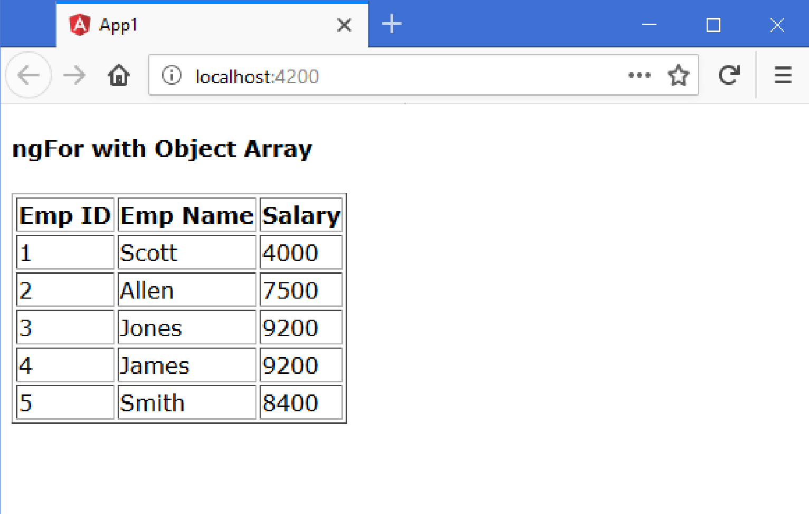

Slide 28
ngFor with Add, Remove
We can allow the user to add new records (objects) to existing array. The user can also delete existing records.
We use “push” function to add new object to array.
We use “splice” function to remove existing object from the array.
Steps:
Adding element to array:
arrayvariable.push(value);
Removing element from array:
arrayvariable.splice(index, count);

Slide 29
ngFor with Add, Remove - Example
Creating Application
Open Command Prompt and enter the following commands:
cd c:\angular
ng new app1
cd c:\angular\app1
ng g class Employee
c: \angular\ app1\ src\ app\ app.module.ts
import {BrowserModule} from '@angular/platform-browser';
import {NgModule} from '@angular/core';
import {AppComponent} from './app.component';
import {FormsModule} from "@angular/forms";
@NgModule({
declarations: [AppComponent],
imports: [BrowserModule, FormsModule],
providers: [],
bootstrap: [AppComponent]
}) export class AppModule {}

Slide 30
c: \angular\ app1\ src\ app\ employee.ts
export class Employee {
empid: number;
empname: string;
salary: number;
constructor(a, b, c) {
this.empid = a;
this.empname = b;
this.salary = c;
}
}

Slide 31
c: \angular\ app1\ src\ app\ app.component.ts
import {Component} from "@angular/core";
import {Employee} from "./employee";
@Component({
selector: 'app-root',
templateUrl: './app.component.html',
styleUrls: ['./app.component.css']
}) export class AppComponent {
employees: Employee[] = [new Employee(1, "Scott", 4000), new Employee(2, "Allen", 7500), new Employee(3, "Jones", 9200), new Employee(4, "James", 9200), new Employee(5, "Smith", 8400)];
newemployee: Employee = new Employee(null, null, null);
onInsertClick() {
this.employees.push(new Employee(this.newemployee.empid, this.newemployee.empname, this.newemployee.salary));
this.newemployee.empid = null;
this.newemployee.empname = null;
this.newemployee.salary = null;
}
onDeleteClick(n) {
if (confirm("Are you sure to delete this employee?")) {
this.employees.splice(n, 1);
}
}
}

Slide 32
c:\angular\app1\src\app\app.component.html <div>
<h4>ngFor with Add, Remove</h4>
<table border="1">
<tr>
<th>Emp ID</th>
<th>Emp Name</th>
<th>Salary</th>
<th></th>
</tr>
<tr *ngFor="let employee of employees; let i = index">
<td>{{employee.empid}}</td>
<td>{{employee.empname}}</td>
<td>{{employee.salary}}</td>
<td><input type="button" value="Delete" (click)="onDeleteClick(i)"></td>
</tr>
<tr>
<td><input type="text" [(ngModel)]="newemployee.empid" placeholder="Emp ID"></td>
<td><input type="text" [(ngModel)]="newemployee.empname" placeholder="Emp Name"></td>
<td><input type="text" [(ngModel)]="newemployee.salary" placeholder="Salary"></td>
<td><input type="button" value="Insert" (click)="onInsertClick()"></td>
</tr>
</table>
</div>

Slide 33
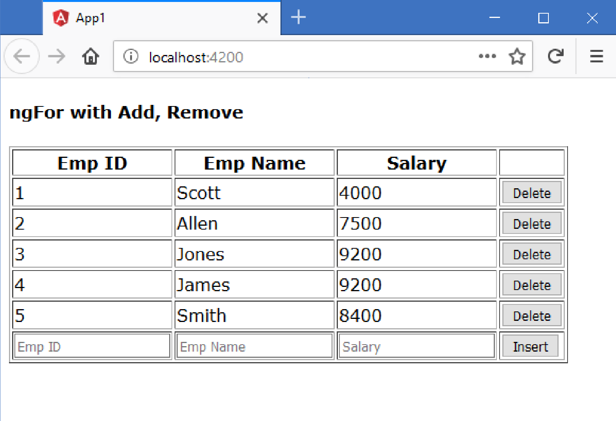

Slide 34
ngFor with Searching and Sorting
We can search for some content in the array.
We can allow the user to sort the data based on a specific property.
We use “filter” function to search content. The filter function receives a callback function, which gets executed once for each item in the array, in the sequence. If the callback function returns “true”, the item will be kept; if it returns “false”, the item will be skipped; thus it collects all the items that has “true”, forms an array with those elements and returns the new array.
We use “sort” function to sort data. The sort function receives a callback function, which gets called for each pair of items in the list. We should return an integer (either negative, 0, or positive). If negative number is returned, the item1 comes first. If the “0” is returned, no changes will be done; original order of items will be kept as it is. If positive number is returned, item2 comes first, item1 is next.

Slide 35
Steps:
Searching:
arryname.filter((item) => { return true or false; } );
Sorting:
arrayname.sort( (item1, item2) => {
if (item1 is less than item2)
return -1;
else if (item1 > item2)
return 1;
else
return 0;
} )
ngFor with Searching and Sorting- Example
Creating Application
Open Command Prompt and enter the following commands:
cd c:\angular ng
new app1
cd c:\angular\app1
ng g class Employee

Slide 36
c: \angular\ app1\ src\ app\ app.component.ts
import {Component} from "@angular/core";
import {Employee} from "./employee";
@Component({
selector: 'app-root',
templateUrl: './app.component.html',
styleUrls: ['./app.component.css']
}) export class AppComponent {
originalemployees: Employee[] = [
new Employee(1, "Scott", 4000),
new Employee(2, "Allen", 7500),
new Employee(3, "Jones", 9200),
new Employee(4, "James", 9200),
new Employee(5, "Smith", 8400)
];
employees: Employee[] = [];
constructor() {
this.employees = this.originalemployees;
}

Slide 37
str: string = "";
sortcolumn = "empid";
order = 1;
onSearchClick() {
this.employees = this.originalemployees.filter((emp) => {
return emp.empname.toLowerCase().indexOf(this.str.toLowerCase()) >= 0;
});
}
onSortClick() {
this.employees = this.originalemployees.sort((emp1, emp2) => {
var n = 0;
if (this.sortcolumn == "empid") {
return (emp1[this.sortcolumn] - emp2[this.sortcolumn]) * this.order;
} else if (this.sortcolumn == "empname") {
return (emp1[this.sortcolumn].charCodeAt(0) - emp2[this.sortcolumn].charCodeAt(0)) * this.order;
} else {
return (emp1[this.sortcolumn] - emp2[this.sortcolumn]) * this.order;
}
});
}
}

Slide 38
c:\angular\app1\src\app\app.component.html
<div>
<h4>ngFor with Searching and Sorting</h4>
<input type="text" placeholder="Search" [(ngModel)]="str">
<input type="button" value="Search" (click)="onSearchClick()"> <br>
Sort: <select [(ngModel)]="sortcolumn">
<option>empid</option>
<option>empname</option>
<option>salary</option>
</select> <select [(ngModel)]="order">
<option value="1">Ascending Order</option>
<option value="-1">Descending Order</option>
</select> <input type="button" value="Sort" (click)="onSortClick()">
<table border="1">
<tr> <th>Emp ID</th> <th>Emp Name</th> <th>Salary</th> </tr>
<tr *ngFor="let employee of employees; let i = index">
<td>{{employee.empid}}</td>
<td>{{employee.empname}}</td>
<td>{{employee.salary}}</td>
</tr>
</table>
</div>

Slide 39
